Slide 1
Improving Diversity in Computer Science
Quad Chart Presentation

Slide 2

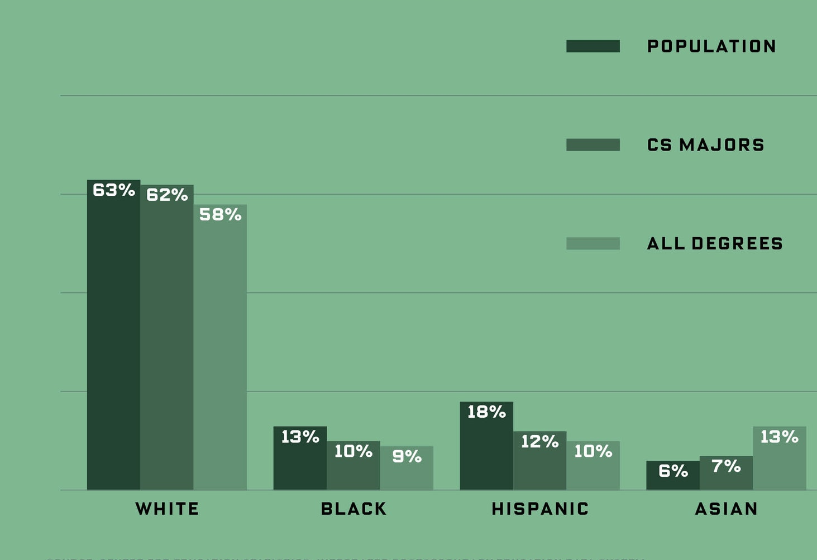
Improving Diversity in Computer Science
Problem: - Limited access to early techeducation - Stereotypes discouraging participation - Lack of role models in the field
- Cultural and financial barriers to accessing CS education.
Solution: - Partner with schools for coding bootcamps - Offer scholarships and mentorship programs - Collaborate with companies for internships
-Curriculum updates to highlight contributions of diverse innovators.
Figure 1:
Proportion of CS Majors by Race/Ethnicity, 2015-2016
Impact Statements: - Creates inclusive environments - Encourages innovation - Helps meet growing demand in the tech industry
- Breaks down cultural and financial barriers in education.
Implementation: - Form alliances with schools and companies - Provide resources like workshops and mentors - Monitor and assess progress with
annual reports

Slide 3
References
Ehrlinger, Joyce, et al. “Do Gender Differences in Perceived Prototypical Computer Scientists and Engineers Contribute to Gender Gaps in Computer Science and Engineering?” Sex Roles, vol. 78, no. 1–2, Jan. 2018, pp. 40–51. EBSCOhost, doi:10.1007/s11199-017-0763-x. Accessed on October 13, 2024.
Xiao-Ming Wang, et al. “Enhancing Students’ Computer Programming Performances, Critical Thinking Awareness and Attitudes towards Programming: An Online Peer-Assessment Attempt.” Journal of Educational Technology & Society, vol. 20, no. 4, Oct. 2017, pp. 58–68. EBSCOhost, ezproxy.libraries.wright.edu/login?url=https://search. ebscohost.com/login.aspx? direct=true&db=a9h&AN=125829901&site=ehost-live&scope=site. Accessed on October 13, 2024.

